Slide 1
LADM
Version September, 9th 2021

Slide 2
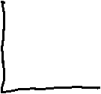






Slide 3







Welcome to the Municipality Waterriver
WR02
WR02
WR04
WR05
WR05
WR06
WR06
WR01
WR01
WR03
WR03
WR16
WR16
WR
15
WR
13
WR
15
WR
13
WR17
WR
14
WR17
WR
12
WR
14
WR
12
WR22
WR21
WR22
WR
11
WR21
WR
11
20
20
WR24
WR23
WR24
WR18
WR23
WR18
WR19
WR19
WR07
WR07
WR30
WR
09
WR30
WR
09
WR32
WR08
WR32
WR08
WR29
WR
10
WR29
WR
10
WR31
WR31
WR26
WR25
WR26
WR25
WR37
WR34
WR37
WR
28
WR34
WR27
WR
28
WR27
WR38
WR38
WR39
WR35
WR39
33
WR35
33
WR40
WR36
WR40
WR36

Slide 4
Cadastral Map Municipality Waterriver
WR04
WR03
WR01
WR02
WR05
WR06
WR02
WR02
WR04
WR05
WR05
WR06
WR06
WR01
WR01
WR03
WR03
WR16
WR07
WR16
WR
12
WR
13
WR
14
WR16
WR18
WR
19
WR11
WR
15
WR
13
WR
15
WR
13
WR17
WR
14
WR17
WR
12
WR
14
WR
12
WR22
WR08
WR21
WR22
WR09
WR
11
WR21
WR
11
20
20
WR24
WR
10
WR23
WR24
WR18
WR23
WR18
WR19
WR19
WR07
WR07
WR30
WR
09
WR30
WR
09
WR20
WR32
WR08
WR32
WR08
WR29
WR
17
WR
10
WR29
WR
10
WR31
WR31
WR21
WR15
WR26
WR25
WR26
WR25
WR37
WR34
WR37
WR
28
WR34
WR27
WR
28
WR27
WR38
WR38
WR22
WR39
WR35
WR39
33
WR35
33
WR40
WR36
WR40
WR36

Slide 5
Public Roads
WR04
WR03
WR01
WR02
WR05
WR06
WR02
WR02
WR04
WR05
WR05
WR06
WR06
WR01
WR01
WR03
WR03
WR16
WR07
WR16
WR
12
WR
13
WR
14
WR16
WR18
WR
19
WR11
WR
15
WR
13
WR
15
WR
13
WR17
WR
14
WR17
WR
12
WR
14
WR
12
WR22
WR08
WR21
WR22
WR09
WR
11
WR21
WR
11
20
20
WR24
WR
10
WR23
WR24
WR18
WR23
WR18
WR19
WR19
WR07
WR07
WR30
WR
09
WR30
WR
09
WR20
WR32
WR08
WR32
WR08
WR29
WR
17
WR
10
WR29
WR
10
WR31
WR31
WR21
WR15
WR26
WR25
WR26
WR25
WR37
WR34
WR37
WR
28
WR34
WR27
WR
28
WR27
WR38
WR38
WR22
WR39
WR35
WR39
33
WR35
33
WR40
WR36
WR40
WR36

Slide 6
WR20 has no access to a public road
WR04
WR03
WR01
WR02
WR05
WR06
WR02
WR02
WR04
WR05
WR05
WR06
WR06
WR01
WR01
WR03
WR03
WR16
WR07
WR16
WR
12
WR
13
WR
14
WR16
WR18
WR
19
WR11
WR
15
WR
13
WR
15
WR
13
WR17
WR
14
WR17
WR
12
WR
14
WR
12
WR22
WR08
WR21
WR22
WR09
WR
11
WR21
WR
11
20
20
WR24
WR
10
WR23
WR24
WR18
WR23
WR18
WR19
WR19
WR07
WR07
WR30
WR
09
WR30
WR
09
WR20
WR32
WR08
WR32
WR08
WR29
WR
17
WR
10
WR29
WR
10
WR31
WR31
WR21
WR15
WR26
WR25
WR26
WR25
WR37
WR34
WR37
WR
28
WR34
WR27
WR
28
WR27
WR38
WR38
WR22
WR39
WR35
WR39
33
WR35
33
WR40
WR36
WR40
WR36

Slide 7
School
WR04
WR03
WR01
WR02
WR05
WR06
WR02
WR02
WR04
WR05
WR05
WR06
WR06
WR01
WR01
WR03
WR03
WR16
WR07
WR16
WR
12
WR
13
WR
14
WR16
WR18
WR
19
WR11
WR
15
WR
13
WR
15
WR
13
WR17
WR
14
WR17
WR
12
WR
14
WR
12
WR22
WR08
WR21
WR22
WR09
WR
11
WR21
WR
11
20
20
WR24
WR
10
WR23
WR24
WR18
WR23
WR18
WR19
WR19
WR07
WR07
WR30
WR
09
WR30
WR
09
WR20
WR32
WR08
WR32
WR08
WR29
WR
17
WR
10
WR29
WR
10
WR31
WR31
WR21
WR15
WR26
WR25
WR26
WR25
WR37
WR34
WR37
WR
28
WR34
WR27
WR
28
WR27
WR38
WR38
WR22
WR39
WR35
WR39
33
WR35
33
WR40
WR36
WR40
WR36

Slide 8
Municipal Offices and Services
WR04
WR03
WR01
WR02
WR05
WR06
WR02
WR02
WR04
WR05
WR05
WR06
WR06
WR01
WR01
WR03
WR03
WR16
WR07
WR16
WR
12
WR
13
WR
14
WR16
WR18
WR
19
WR11
WR
15
WR
13
WR
15
WR
13
WR17
WR
14
WR17
WR
12
WR
14
WR
12
WR22
WR08
WR21
WR22
WR09
WR
11
WR21
WR
11
20
20
WR24
WR
10
WR23
WR24
WR18
WR23
WR18
WR19
WR19
WR07
WR07
WR30
WR
09
WR30
WR
09
WR20
WR32
WR08
WR32
WR08
WR29
WR
17
WR
10
WR29
WR
10
WR31
WR31
WR21
WR15
WR26
WR25
WR26
WR25
WR37
WR34
WR37
WR
28
WR34
WR27
WR
28
WR27
WR38
WR38
WR22
WR39
WR35
WR39
33
WR35
33
WR40
WR36
WR40
WR36

Slide 9
Apartment
WR04
WR03
WR01
WR02
WR05
WR06
WR02
WR02
WR04
WR05
WR05
WR06
WR06
WR01
WR01
WR03
WR03
WR16
WR07
WR16
WR
12
WR
13
WR
14
WR16
WR18
WR
19
WR11
WR
15
WR
13
WR
15
WR
13
WR17
WR
14
WR17
WR
12
WR
14
WR
12
WR22
WR08
WR21
WR22
WR09
WR
11
WR21
WR
11
20
20
WR24
WR
10
WR23
WR24
WR18
WR23
WR18
WR19
WR19
WR07
WR07
WR30
WR
09
WR30
WR
09
WR20
WR32
WR08
WR32
WR08
WR29
WR
17
WR
10
WR29
WR
10
WR31
WR31
WR21
WR15
WR26
WR25
WR26
WR25
WR37
WR34
WR37
WR
28
WR34
WR27
WR
28
WR27
WR38
WR38
WR22
WR39
WR35
WR39
33
WR35
33
WR40
WR36
WR40
WR36

Slide 10
WR22 is 1 sqm – electrical power distribution
WR04
WR03
WR01
WR02
WR05
WR06
WR02
WR02
WR04
WR05
WR05
WR06
WR06
WR01
WR01
WR03
WR03
WR16
WR07
WR16
WR
12
WR
13
WR
14
WR16
WR18
WR
19
WR11
WR
15
WR
13
WR
15
WR
13
WR17
WR
14
WR17
WR
12
WR
14
WR
12
WR22
WR08
WR21
WR22
WR09
WR
11
WR21
WR
11
20
20
WR24
WR
10
WR23
WR24
WR18
WR23
WR18
WR19
WR19
WR07
WR07
WR30
WR
09
WR30
WR
09
WR20
WR32
WR08
WR32
WR08
WR29
WR
17
WR
10
WR29
WR
10
WR31
WR31
WR21
WR15
WR26
WR25
WR26
WR25
WR37
WR34
WR37
WR
28
WR34
WR27
WR
28
WR27
WR38
WR38
WR22
WR39
WR35
WR39
33
WR35
33
WR40
WR36
WR40
WR36
WR
22

Slide 11
Carlos owns WR01
WR04
WR03
WR01
WR02
WR05
WR06
WR02
WR02
WR04
WR05
WR05
WR06
Ownership
WR06
WR01
WR01
Carlos
WR03
WR03
WR16
WR07
WR16
WR
12
WR
13
WR
14
WR16
WR18
WR
19
WR11
WR
15
WR
13
WR
15
WR
13
WR17
WR
14
WR17
WR
12
WR
14
WR
12
WR22
WR08
WR21
WR22
WR09
WR
11
WR21
WR
11
20
20
WR24
WR
10
WR23
WR24
WR18
WR23
WR18
WR19
WR19
WR07
WR07
WR30
WR
09
WR30
WR
09
WR20
WR32
WR08
WR32
WR08
WR29
WR
17
WR
10
WR29
WR
10
WR31
WR31
WR21
WR15
WR26
WR25
WR26
WR25
WR37
WR34
WR37
WR
28
WR34
WR27
WR
28
WR27
WR38
WR38
WR22
WR39
WR35
WR39
33
WR35
33
WR40
WR36
WR40
WR36

Slide 12
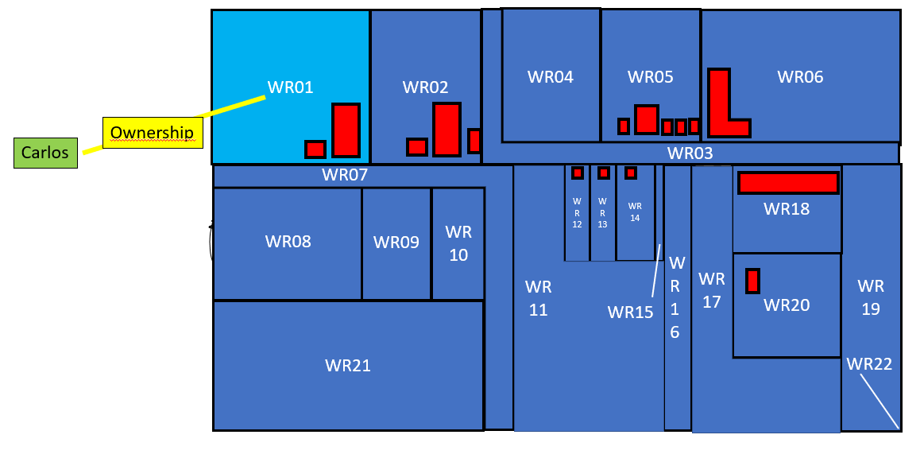
Carlos
Carlos P01
Ownership Right01
BAU01
WR01

Slide 13
BAU01?
?
Carlos P01
Ownership Right01
BAU01
WR01

Slide 14
Elisabeth and Thomas own WR02, WR08 and WR10
WR04
WR03
WR01
WR02
WR05
WR06
Thomas
WR02
WR02
WR04
WR05
WR05
WR06
WR06
WR01
Ownership
WR01
WR03
WR03
WR16
WR07
WR16
WR
12
WR
13
WR
14
WR16
WR18
WR
19
WR11
WR
15
WR
13
WR
15
WR
13
WR17
WR
14
WR17
WR
12
WR
14
WR
12
WR22
WR08
WR21
WR22
WR09
WR
11
WR21
WR
11
20
20
WR24
WR
10
WR23
WR24
WR18
WR23
WR18
WR19
Elisabeth
WR19
WR07
WR07
WR30
WR
09
WR30
WR
09
WR20
WR32
WR08
WR32
WR08
WR29
WR
17
WR
10
WR29
WR
10
WR31
WR31
WR21
WR15
WR26
WR25
WR26
WR25
WR37
WR34
WR37
WR
28
WR34
WR27
WR
28
WR27
WR38
WR38
WR22
WR39
WR35
WR39
33
WR35
33
WR40
WR36
WR40
WR36

Slide 15
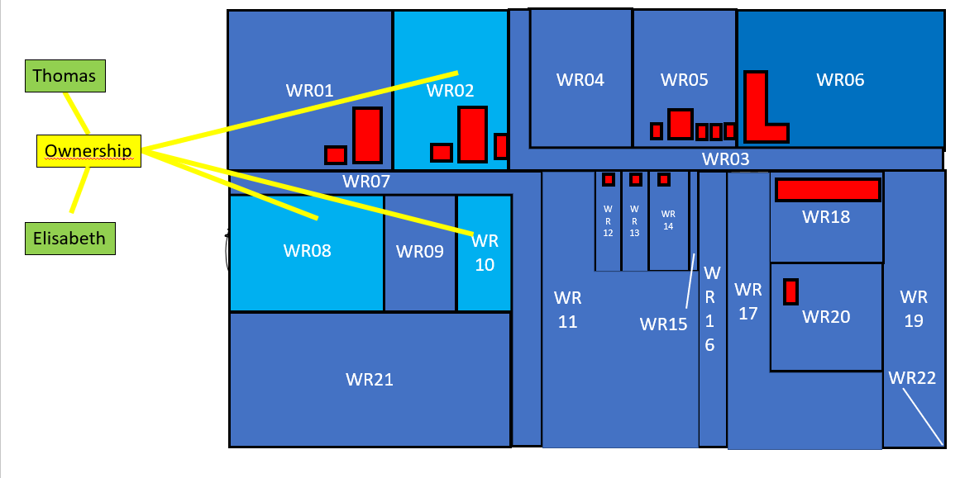
In LADM we say that Elisabeth and Thomas both have a share in the owership of BAU02
Tomas P02
½ Ownership Right02
WR02
BAU02
WR08
Elisabeth P03
½ Ownership Right02
WR10

Slide 16
BAU02 consists out of WR02, WR08, WR10
One property, three spatial units (parcels)
Tomas P02
½ Ownership Right02
WR02
BAU02
WR08
Elisabeth P03
½ Ownership Right02
WR10

Slide 17
Municipality Waterriver
WR04
WR03
WR01
WR02
WR05
WR06
Ownership
WR02
WR02
WR04
WR05
WR05
WR06
WR06
WR01
WR01
WR03
WR03
WR16
WR07
WR16
WR
12
WR
13
WR
14
WR16
WR18
WR
19
WR11
WR
15
WR
13
WR
15
WR
13
WR17
WR
14
WR17
WR
12
WR
14
WR
12
WR22
WR08
WR21
WR22
WR09
WR
11
WR21
WR
11
20
20
WR24
WR
10
WR23
WR24
WR18
WR23
WR18
WR19
Municipality Waterriver
WR19
WR07
WR07
WR30
WR
09
WR30
WR
09
WR20
WR32
WR08
WR32
WR08
WR29
WR
17
WR
10
WR29
WR
10
WR31
WR31
WR21
WR15
WR26
WR25
WR26
WR25
WR37
WR34
WR37
WR
28
WR34
WR27
WR
28
WR27
WR38
WR38
WR22
WR39
WR35
WR39
33
WR35
33
WR40
WR36
WR40
WR36

Slide 18
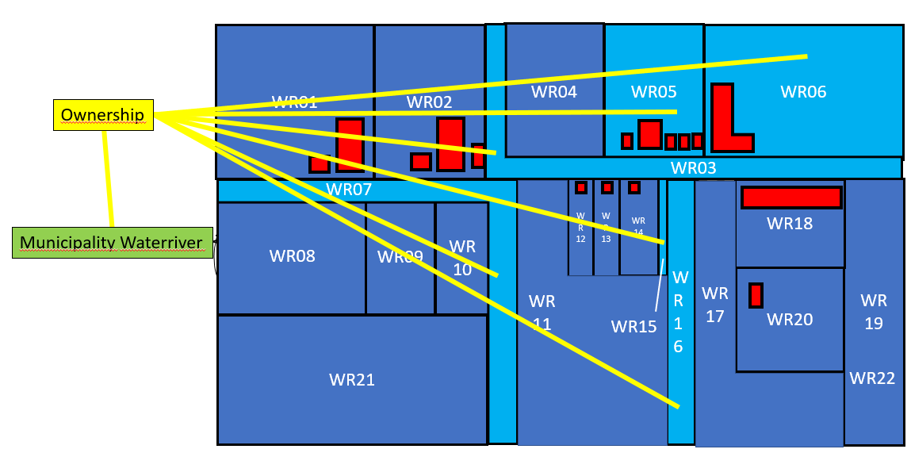
WR03
WR05
WR06
Municipality P04
Ownership Right03
BAU03
WR07
Municipality owns BAU03 consisting out of WR03, WR05, WR06, WR07, WR15 & WR16
WR15
WR16

Slide 19
The Cooperation and Anna
Anna
WR04
WR03
WR01
WR02
WR05
WR06
Ownership
WR02
WR02
WR04
WR05
Ownership
WR05
WR06
WR06
WR01
WR01
WR03
WR03
WR16
WR07
WR16
Cooperation
WR
12
WR
13
WR
14
WR16
WR18
WR
19
WR11
WR
15
WR
13
WR
15
WR
13
WR17
WR
14
WR17
WR
12
WR
14
WR
12
WR22
WR08
WR21
WR22
WR09
WR
11
WR21
WR
11
20
20
WR24
WR
10
WR23
WR24
WR18
WR23
WR18
WR19
WR19
WR07
WR07
WR30
WR
09
WR30
Ownership
WR
09
WR20
WR32
WR08
WR32
WR08
WR29
WR
17
WR
10
WR29
WR
10
WR31
WR31
WR21
WR15
WR26
Ownership
WR25
WR26
WR25
WR37
WR34
WR37
WR
28
WR34
WR27
WR
28
WR27
WR38
WR38
WR22
WR39
WR35
WR39
33
WR35
33
WR40
WR36
WR40
WR36

Slide 20
Share in Rights or Shareholders
Anna P05
9/10 Ownership Right04
BAU04
WR04
Cooperation P06
1/10 Ownership Right04
Alternative: parties Anna and Cooperation as members of group party
Anna P05
9/10
Consortium Anna & Cooperation
Ownership Right04
BAU04
WR04
1/10
Cooperation P06
PartyMember is an associative class

Slide 21
Share in Rights
Anna P05
9/10 Ownership Right04
BAU04
WR04
Cooperation P06
1/10 Ownership Right04
9/10 Anna P05
Consortium Anna & Cooperation
Ownership Right04
BAU04
WR04
1/10 Cooperation P06

Slide 22
Shareholders
Anna P05
9/10 Ownership Right04
BAU04
WR04
Cooperation P06
1/10 Ownership Right04
PartyMemberAnna P05
9/10
GroupPart Consortium Anna & Cooperation
Ownership Right04
BAU04
WR04
1/10
PartyMember
Cooperation P06
PartyMember is an associative class

Slide 23
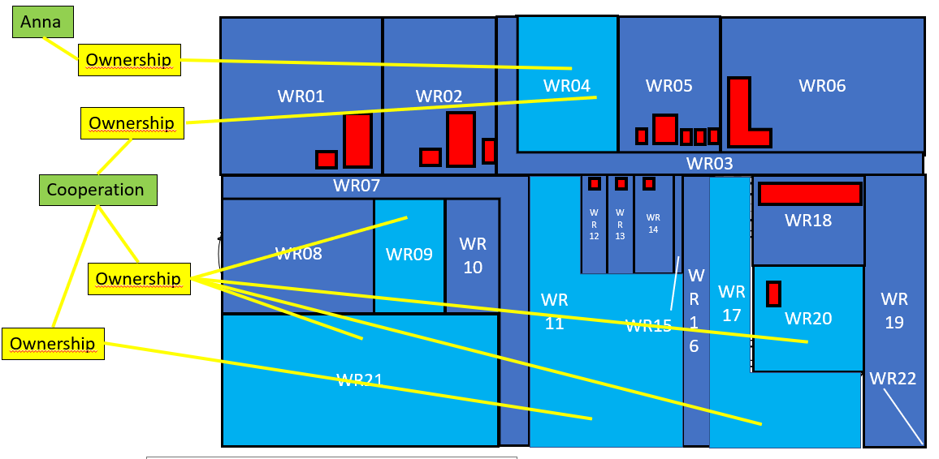
Anna has a share 9/10th in the ownership of BAU04
The Cooperation has a share 1/10th
The Cooperation further owns BAU05 and BAU06
Anna P05
9/10 Ownership Right04
WR04
BAU04
WR09
1/10 Ownership Right04
WR17
WR20
Cooperation P06
Ownership Right05
BAU05
WR21
Ownership Right06
BAU06
WR11

Slide 24
There is a Mortgage (restriction) and a Usufruct on BAU06 whith Spatial Unit WR11
WR04
WR03
WR01
WR02
WR05
WR06
WR02
WR02
WR04
WR05
WR05
WR06
WR06
WR01
WR01
WR03
WR03
WR16
Capital Bank
WR07
WR16
WR
12
WR
13
WR
14
WR16
WR18
WR
19
WR11
WR
15
WR
13
WR
15
WR
13
WR17
WR
14
WR17
WR
12
WR
14
WR
12
WR22
WR08
WR21
WR22
WR09
WR
11
WR21
WR
11
20
20
WR24
WR
10
WR23
WR24
WR18
WR23
WR18
WR19
WR19
WR07
WR07
WR30
WR
09
WR30
Mortgage
WR
09
WR20
WR32
WR08
WR32
WR08
WR29
WR
17
WR
10
WR29
WR
10
WR31
WR31
WR21
WR15
WR26
WR25
WR26
WR25
WR37
WR34
WR37
WR
28
WR34
WR27
WR
28
Usufruct
WR27
WR38
WR38
WR22
WR39
WR35
WR39
33
WR35
33
WR40
WR36
WR40
WR36
Municipality

Slide 25
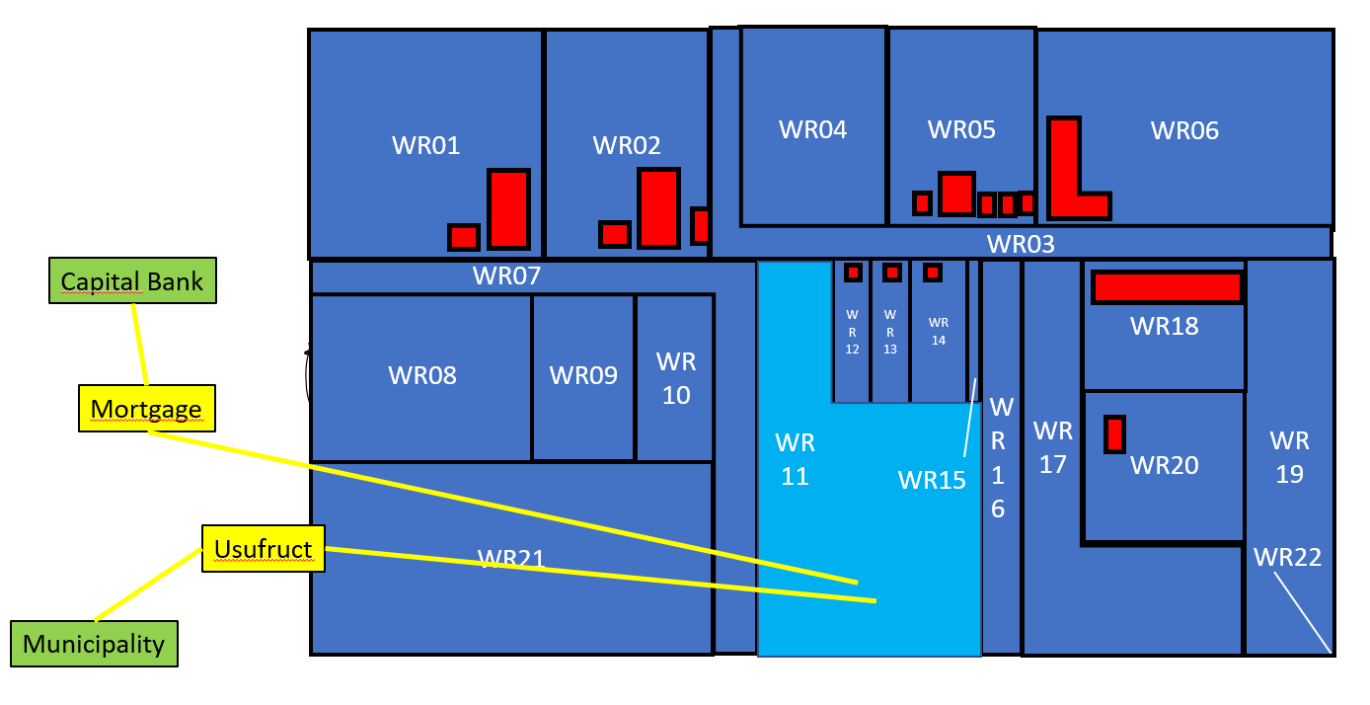
Cooperation has a Mortgage on BAU06 and
Municipality a usufruct
Cooperation P06
Ownership Right06
Municipality P04
Usufruct Right07
BAU06
WR11
Capital Bank P07
Mortgage Restriction01

Slide 26
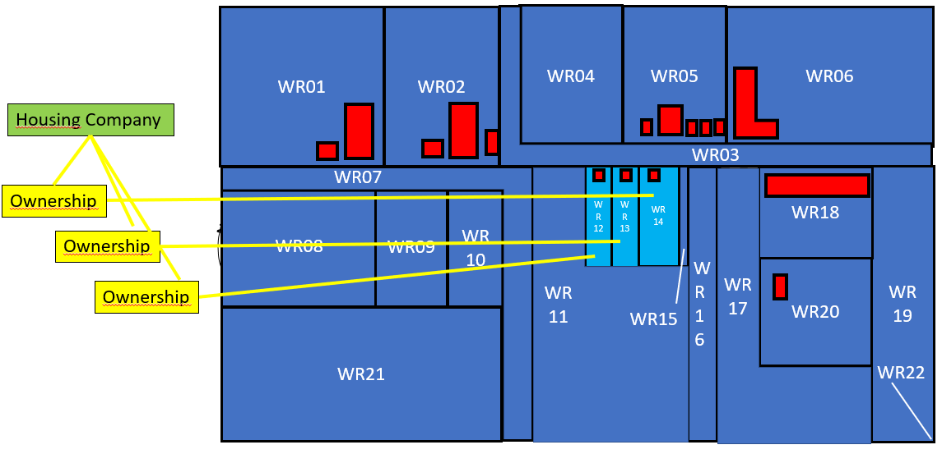
Housing Company

Slide 27
Ownership Right08
BAU07
WR12
Housing
Company P08
Ownership Right09
BAU08
WR13
Ownership Right10
BAU09
WR14

Slide 28
Housing Company and its LongLeaseholders
WR04
WR03
WR01
WR02
WR05
WR06
Maria and Johan
WR02
WR02
WR04
WR05
WR05
WR06
WR06
WR01
LongLease
WR01
WR03
WR03
WR16
WR07
WR16
WR
12
WR
13
WR
14
WR16
WR18
WR
19
WR11
WR
15
WR
13
WR
15
WR
13
WR17
WR
14
WR17
WR
12
WR
14
WR
12
WR22
WR08
WR21
WR22
WR09
WR
11
WR21
WR
11
20
20
WR24
WR
10
WR23
WR24
WR18
WR23
WR18
WR19
WR19
WR07
Anton
LongLease
WR07
WR30
WR
09
WR30
WR
09
WR20
WR32
WR08
WR32
WR08
WR29
WR
17
WR
10
WR29
WR
10
WR31
WR31
WR21
WR15
WR26
WR25
WR26
WR25
WR37
WR34
WR37
WR
28
WR34
LongLease
WR27
WR
28
WR27
WR38
WR38
WR22
WR39
WR35
WR39
33
WR35
33
WR40
WR36
WR40
WR36
James

Slide 29
Housing Company and Maria and Johan
WR04
WR03
WR01
WR02
WR05
WR06
Housing Company
WR02
WR02
WR04
WR05
WR05
WR06
WR06
WR01
WR01
WR03
Ownership
WR03
WR16
WR07
WR16
WR
12
WR
13
WR
14
WR16
WR18
WR
19
WR11
WR
15
WR
13
WR
15
WR
13
WR17
WR
14
WR17
WR
12
WR
14
WR
12
WR22
WR08
WR21
WR22
WR09
WR
11
WR21
WR
11
20
20
WR24
WR
10
WR23
WR24
WR18
WR23
WR18
WR19
WR19
LongLease
WR07
WR07
WR30
WR
09
WR30
WR
09
WR20
WR32
WR08
WR32
WR08
WR29
WR
17
WR
10
WR29
WR
10
WR31
WR31
WR21
WR15
WR26
Maria and Johan
WR25
WR26
WR25
WR37
WR34
WR37
WR
28
WR34
WR27
WR
28
WR27
WR38
WR38
WR22
WR39
WR35
WR39
33
WR35
33
WR40
WR36
WR40
WR36

Slide 30
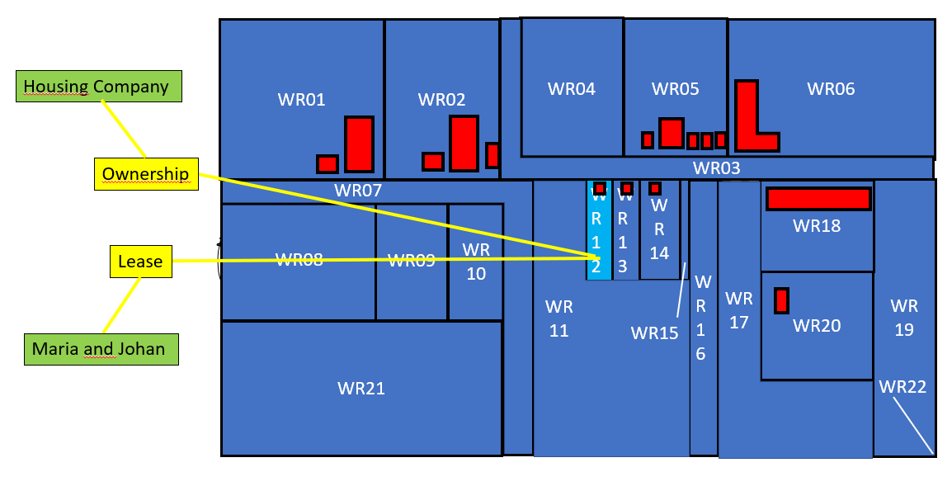
Housing Company and Maria and Johan
Housing
Company P08
Ownership Right08
Maria P09
½ LongLease Right11
BAU07
WR12
Johan P10
½ LongLease Right11

Slide 31
Housing Company and Anton
WR04
WR03
WR01
WR02
WR05
WR06
WR02
WR02
WR04
WR05
WR05
Housing Company
WR06
WR06
WR01
WR01
WR03
WR03
WR16
WR07
WR16
WR11
WR
12
WR
13
WR
14
WR16
WR18
WR
19
WR
15
WR
13
WR
15
WR
13
WR17
WR
14
WR17
WR
12
WR
14
WR
12
WR22
WR08
WR21
WR22
WR09
WR
11
WR21
WR
11
20
20
WR24
WR
10
WR23
WR24
WR18
WR23
WR18
WR19
WR19
Ownership
WR07
WR07
WR30
WR
09
WR30
WR
09
WR20
WR32
WR08
WR32
WR08
WR29
WR
17
WR
10
WR29
WR
10
WR31
WR31
LongLease
WR21
WR15
WR26
WR25
WR26
WR25
WR37
WR34
WR37
Anton
WR
28
WR34
WR27
WR
28
WR27
WR38
WR38
WR22
WR39
WR35
WR39
33
WR35
33
WR40
WR36
WR40
WR36

Slide 32
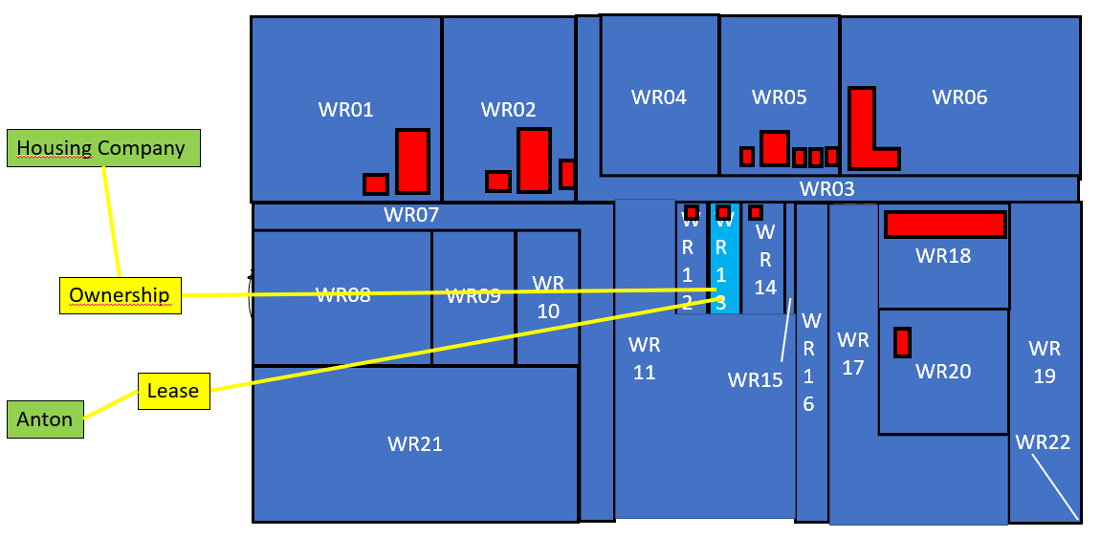
Housing Company and Anton
Housing
Company P08
Ownership Right09
BAU08
WR13
Anton P11
Leasehold Right12

Slide 33
There is a Mortgage on Anton’s LongLease
WR04
WR03
WR01
WR02
WR05
WR06
WR02
WR02
WR04
WR05
WR05
Housing Company
WR06
WR06
WR01
WR01
WR03
WR03
WR16
WR07
WR16
WR11
WR
12
WR
13
WR
14
WR16
WR18
WR
19
WR
15
WR
13
WR
15
WR
13
WR17
WR
14
WR17
WR
12
WR
14
WR
12
WR22
WR08
WR21
WR22
WR09
WR
11
WR21
WR
11
20
20
WR24
WR
10
WR23
WR24
WR18
WR23
WR18
WR19
WR19
Ownership
WR07
WR07
WR30
WR
09
WR30
WR
09
WR20
WR32
WR08
WR32
WR08
WR29
WR
17
WR
10
WR29
WR
10
WR31
WR31
LongLease
WR21
WR15
WR26
WR25
WR26
WR25
WR37
WR34
WR37
Anton
WR
28
WR34
WR27
WR
28
WR27
WR38
WR38
WR22
WR39
WR35
WR39
33
WR35
33
WR40
Capital Bank
WR36
WR40
Mortgage
WR36

Slide 34
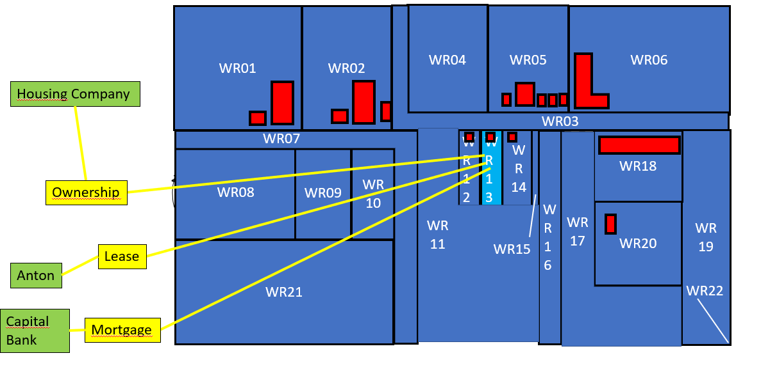
There is a Mortgage on Anton’s Leasehold
Housing
Company P08
Ownership Right09
Anton P11
Leasehold Right12
BAU08
WR13
Capital Bank P07
Mortgage Restriction02

Slide 35
Capital Bank
Mortgage Restriction01
BAU06
WR11
Capital Bank P07
Mortgage Restriction02
BAU08
WR13

Slide 36
Housing Company and James
WR04
WR03
WR01
WR02
WR05
WR06
Housing Company
WR02
WR02
WR04
WR05
WR05
WR06
WR06
WR01
WR01
WR03
Ownership
WR03
WR16
WR07
WR16
WR
12
WR
13
WR
14
WR16
WR18
WR
19
WR11
WR
15
WR
13
WR
15
WR
13
WR17
WR
14
WR17
WR
12
WR
14
WR
12
WR22
WR08
WR21
WR22
WR09
WR
11
WR21
WR
11
20
20
WR24
WR
10
WR23
WR24
WR18
WR23
WR18
WR19
WR19
WR07
WR07
WR30
WR
09
WR30
WR
09
WR20
WR32
WR08
WR32
WR08
WR29
WR
17
WR
10
WR29
WR
10
WR31
WR31
WR21
WR15
WR26
WR25
WR26
WR25
WR37
WR34
WR37
WR
28
WR34
Lease
WR27
WR
28
WR27
WR38
WR38
WR22
WR39
WR35
WR39
33
WR35
33
WR40
WR36
WR40
WR36
James

Slide 37
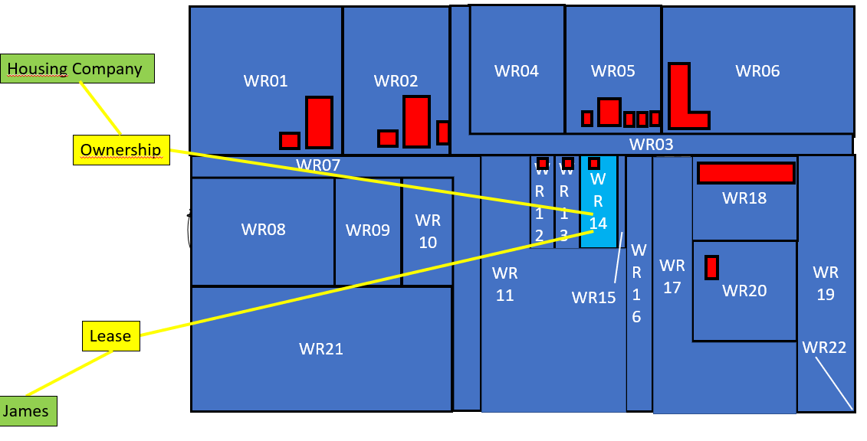
Housing Company and James
Housing Company P08
Ownership Right10
BAU09
WR14
James P12
Leasehold Right13

Slide 38
Association of Owners
WR04
WR03
WR01
WR02
WR05
WR06
Association of Owners
WR02
WR02
WR04
WR05
WR05
WR06
WR06
WR01
WR01
WR03
WR03
WR16
WR07
WR16
WR
12
WR
13
WR
14
WR16
WR18
WR
19
WR11
WR
15
WR
13
WR
15
WR
13
WR17
WR
14
WR17
WR
12
WR
14
WR
12
WR22
WR08
WR21
WR22
WR09
WR
11
WR21
WR
11
20
20
WR24
WR
10
WR23
WR24
WR18
WR23
Ownership
WR18
WR19
WR19
WR07
WR07
WR30
WR
09
WR30
WR
09
WR20
WR32
WR08
WR32
WR08
WR29
WR
17
WR
10
WR29
WR
10
WR31
WR31
WR21
WR15
WR26
WR25
WR26
WR25
WR37
WR34
WR37
WR
28
WR34
WR27
WR
28
WR27
WR38
WR38
WR22
WR39
WR35
WR39
33
WR35
33
WR40
WR36
WR40
WR36

Slide 39
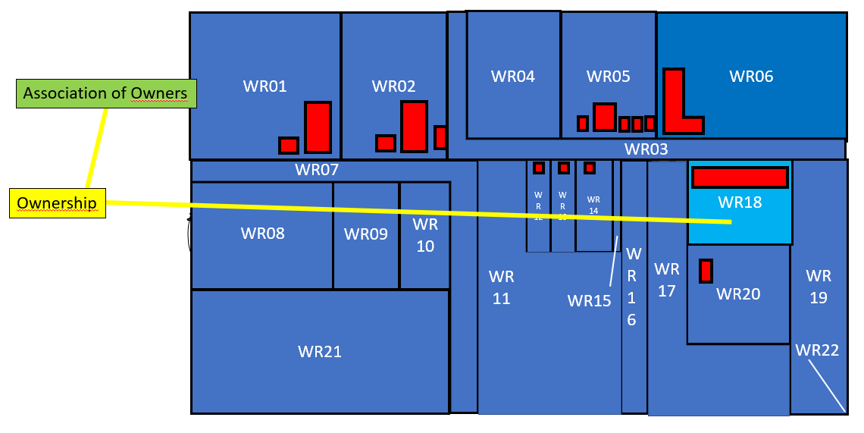
Association of Owners
Association of Owners P13
Ownership Right14
BAU10
WR18

Slide 40
Association
of owners also owns the common area’s
in an
Apartment
Building with
3 floors

Slide 41
Roof

Slide 42
Appartment
Gallery

Slide 43
Elevator and Utilities

Slide 44
Roof
Appartment
Gallery
Common
Property
Elevator and Utilities

Slide 45
Spatial
Unit
WR18-1
Spatial
Unit
WR18-2
BAU11
Spatial
Unit
WR18-3

Slide 46
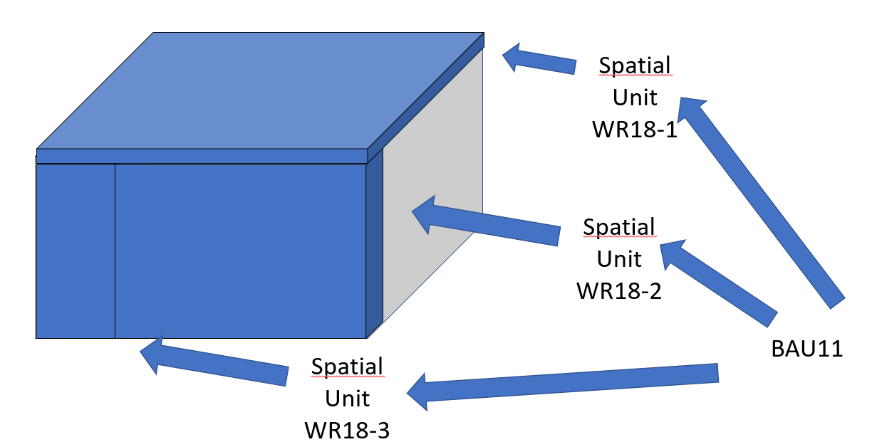
Association of Owners
Ownership Right14
BAU10
WR18
Association of Owners P13
WR18-1
Ownership Right15
BAU11
WR18-2
WR18-3

Slide 47
Monique is apartment owner and member of the association of owners
Apartment

Slide 48
Monique
Laundry Room

Slide 49
Monique
Parking Lot

Slide 50
Monique
Apartment
Parking Lot
Property
Laundry Room

Slide 51
Monique
Spatial
Unit
WR18-4
Spatial
Unit
WR18-5
Basic
Administrative
Unit 12
Spatial
Unit
WR18-6

Slide 52
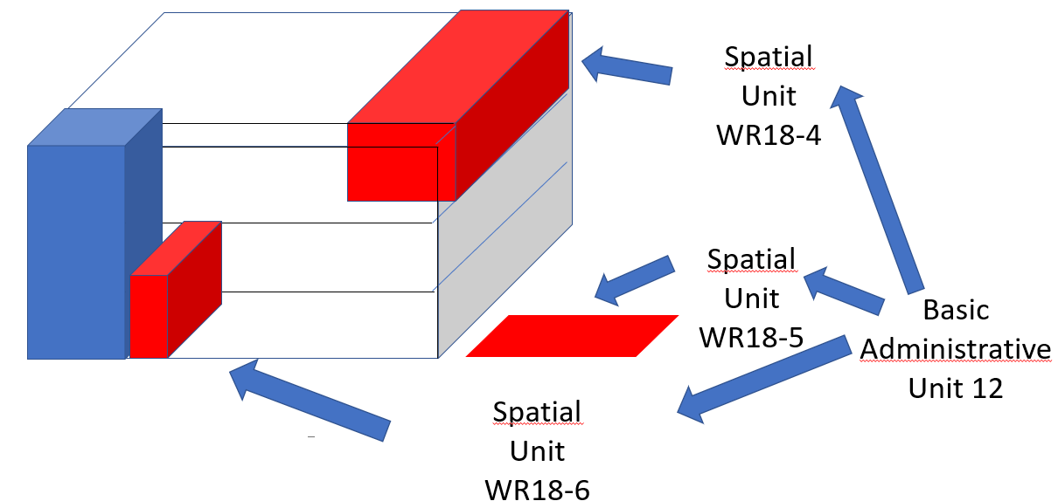
Monique
WR18-4
Monique P14
Ownership Right16
BAU12
WR18-5
WR18-6

Slide 54
Monique is member of the Association of Owners
Association of Owners P13
Ownership Right14
BAU10
WR18
WR18-4
Monique P14
Ownership Right16
BAU12
WR18-5
WR18-6

Slide 55
Eco Investment
WR04
WR03
WR01
WR02
WR05
WR06
WR02
WR02
WR04
WR05
WR05
WR06
WR06
Eco Investment
WR01
WR01
WR03
WR03
WR16
WR07
WR16
WR
12
WR
13
WR
14
WR16
WR18
WR
19
WR11
WR
15
WR
13
WR
15
WR
13
WR17
WR
14
WR17
WR
12
WR
14
WR
12
WR22
WR08
WR21
WR22
WR09
WR
11
WR21
WR
11
20
20
WR24
WR
10
WR23
WR24
WR18
WR23
WR18
WR19
Ownership
WR19
WR07
WR07
WR30
WR
09
WR30
WR
09
WR20
WR32
WR08
WR32
WR08
WR29
WR
17
WR
10
WR29
WR
10
WR31
WR31
WR21
WR15
WR26
WR25
WR26
WR25
WR37
WR34
WR37
WR
28
WR34
WR27
WR
28
WR27
WR38
WR38
WR22
WR39
WR35
WR39
33
WR35
33
WR40
WR36
WR40
WR36
WR
22

Slide 56
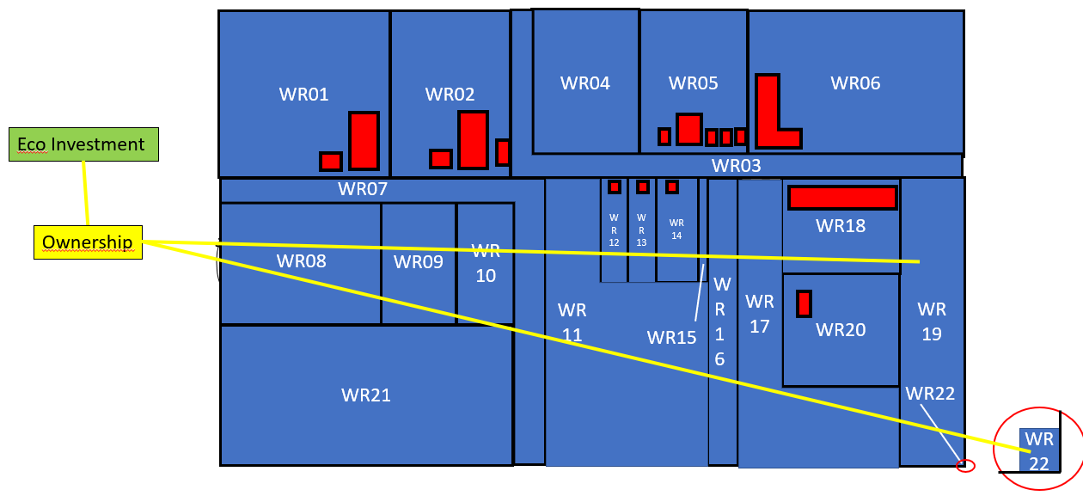
Eco Investment
WR19
Eco Investment P15
Ownership Right17
BAU13
WR22

Slide 57
Eco Investment has a servitude on BAU13 (with WR19 and WR22)
WR04
WR03
WR01
WR02
WR05
WR06
Servitude
WR02
WR02
WR04
WR05
WR05
WR06
WR06
Eco Investment
WR01
WR01
WR03
WR03
WR16
WR07
WR16
WR
12
WR
13
WR
14
WR16
WR18
WR
19
WR11
WR
15
WR
13
WR
15
WR
13
WR17
WR
14
WR17
WR
12
WR
14
WR
12
WR22
WR08
WR21
WR22
WR09
WR
11
WR21
WR
11
20
20
WR24
WR
10
WR23
WR24
WR18
WR23
WR18
WR19
Ownership
WR19
WR07
WR07
WR30
WR
09
WR30
WR
09
WR20
WR32
WR08
WR32
WR08
WR29
WR
17
WR
10
WR29
WR
10
WR31
WR31
WR21
WR15
WR26
WR25
WR26
WR25
WR37
WR34
WR37
WR
28
WR34
WR27
WR
28
WR27
WR38
WR38
WR22
WR39
WR35
WR39
33
WR35
33
WR40
WR36
WR40
WR36
WR
22

Slide 58
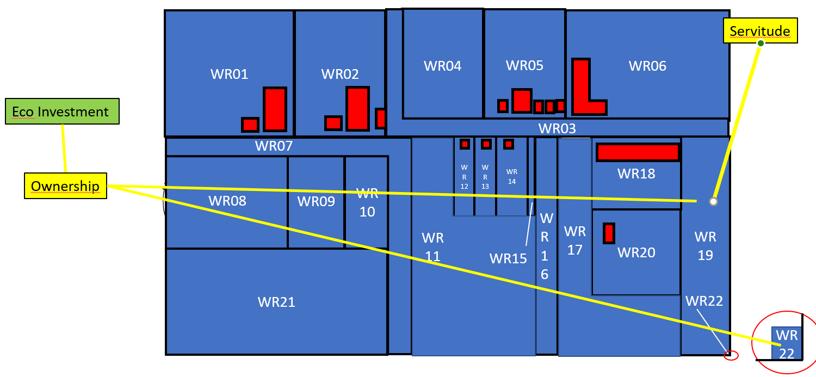
Eco Investment needs to give access to WR20
Note 1: a servitude is a restriction
Note 2: unknown if the access is via WR19 or WR22, those spatial units are the result of an earlier parcel subdivision. The servitude is “inherited” from the earlier spatial unit with both WR19 and WR22
Note 3: for the Restriction01 no LA_Party
is required
This means the attribute partyRequired = ‘0’
for this case
Eco Investment P15
Ownership Right17
WR19
BAU13
Restriction01
WR22

Slide 59
Purposes

Slide 60
Purpose 1: Tenure Security
WR04
WR03
WR01
WR02
WR05
WR06
WR02
WR02
WR04
WR05
WR05
WR06
WR06
WR01
WR01
WR03
WR03
WR16
WR07
WR16
WR
12
WR
13
WR
14
WR16
WR18
WR
19
WR11
WR
15
WR
13
WR
15
WR
13
WR17
WR
14
WR17
WR
12
WR
14
WR
12
WR22
WR08
WR21
WR22
WR09
WR
11
WR21
WR
11
20
20
WR24
WR
10
WR23
WR24
WR18
WR23
WR18
WR19
WR19
WR07
WR07
WR30
WR
09
WR30
WR
09
WR20
WR32
WR08
WR32
WR08
WR29
WR
17
WR
10
WR29
WR
10
WR31
WR31
WR21
WR15
WR26
WR25
WR26
WR25
WR37
WR34
WR37
WR
28
WR34
WR27
WR
28
WR27
WR38
WR38
WR22
WR39
WR35
WR39
33
WR35
33
WR40
WR36
WR40
WR36
WR
22

Slide 61
Purpose 2: Land Taxation
Valuation
WR04
WR03
WR01
WR02
WR05
WR06
WR02
WR02
WR04
WR05
WR05
WR06
WR06
WR01
WR01
WR03
WR03
WR16
WR07
WR16
WR
12
WR
13
WR
14
WR16
WR18
WR
19
WR11
WR
15
WR
13
WR
15
WR
13
WR17
WR
14
WR17
WR
12
WR
14
WR
12
WR22
WR08
WR21
WR22
WR09
WR
11
WR21
WR
11
20
20
WR24
WR
10
WR23
WR24
WR18
WR23
WR18
WR19
Non Taxable
WR19
WR07
WR07
WR30
WR
09
WR30
WR
09
WR20
WR32
Taxable
WR08
WR32
WR08
WR29
WR
17
WR
10
WR29
WR
10
WR31
WR31
WR21
WR15
WR26
WR25
WR26
WR25
WR37
WR34
WR37
WR
28
WR34
WR27
WR
28
WR27
WR38
WR38
WR22
WR39
WR35
WR39
33
WR35
33
WR40
WR36
WR40
WR36
WR
22

Slide 62
Purpose 3: Spatial Planning
Zoning Plan is based on Cadastral Parcels
WR04
WR03
Building
WR01
WR02
WR05
WR06
Urban
WR02
WR02
WR04
WR05
WR05
WR06
Facilities
WR06
WR01
WR01
WR03
WR03
WR16
Agriculture
WR07
WR16
WR
12
WR
13
WR
14
WR16
WR18
WR
19
WR11
WR
15
WR
13
WR
15
WR
13
WR17
WR
14
WR17
WR
12
WR
14
WR
12
WR22
WR08
WR21
WR22
WR09
WR
11
WR21
WR
11
20
20
WR24
WR
10
WR23
WR24
WR18
WR23
WR18
WR19
Water
WR19
WR07
WR07
WR30
WR
09
WR30
WR
09
WR20
WR32
Forest
WR08
WR32
WR08
WR29
WR
17
WR
10
WR29
WR
10
WR31
WR31
WR21
WR15
WR26
Park
WR25
WR26
WR25
WR37
WR34
WR37
WR
28
WR34
WR27
WR
28
WR27
WR38
WR38
WR22
Industry
WR39
WR35
WR39
33
WR35
33
WR40
WR36
WR40
WR36
WR
22
Windpark

Slide 63
Transactions
Buying/selling
Establishment of rights/restrictions/responsibilities
Ending rights/restrictions/responsibilities

Slide 64
Transaction01: Carlos sells WR01 to Monique
WR04
WR03
WR01
WR02
WR05
WR06
WR02
WR02
WR04
WR05
WR05
WR06
Ownership
WR06
WR01
WR01
Carlos
WR03
WR03
WR16
WR07
WR16
WR
12
WR
13
WR
14
WR16
WR18
WR
19
WR11
WR
15
WR
13
WR
15
WR
13
WR17
WR
14
WR17
WR
12
WR
14
WR
12
WR22
WR08
WR21
WR22
WR09
WR
11
WR21
WR
11
20
20
WR24
WR
10
WR23
WR24
WR18
WR23
WR18
WR19
WR19
Ownership
WR07
WR07
WR30
WR
09
WR30
Monique
WR
09
WR20
WR32
WR08
WR32
WR08
WR29
WR
17
WR
10
WR29
WR
10
WR31
WR31
WR21
WR15
WR26
WR25
WR26
WR25
WR37
WR34
WR37
WR
28
WR34
WR27
WR
28
WR27
WR38
WR38
WR22
WR39
WR35
WR39
33
WR35
33
WR40
WR36
WR40
WR36

Slide 65
Transaction01: Carlos sells WR01 to Monique at 26-08-2021
Carlos P01
Ownership Right01
BAU01
WR01
Monique P14
Ownership Right18
BAU14
WR01

Slide 66
Transaction01: Carlos sells WR01 to Monique at 26-08-2021 means new Oid’s
Carlos P01
Ownership Right01
BAU01
WR01
Monique P14
Ownership Right18
BAU14
WR01
The rID did changed in this example, it can be seen as a new right
Note: Oid’s are object identifiers,not the database id’s
rID | LA_Right_Type | beginLifespan | endLifespan
Right01 | Ownership | 20150403, 08:29 | 20210826, 14:04
Right18 | Ownership | 20210826, 14:04 | 99999999, 23:59

Slide 67
Transaction01: Carlos sells WR01 to Monique at 26-08-2021
Carlos P01
Ownership Right01
BAU01
WR01
Monique P14
Ownership Right01
BAU01
WR01
But it also could stay as Right01, but consider inclusion of time attributes as part if the rID to make it unique
This means there are alternative options for managing identifiers, the approach to be followed is a design choice
rID | LA_Right_Type | beginLifespan | endLifespan
Right01 | Ownership | 20150403, 08:29 | 20210826, 14:04
Right01 | Ownership | 20210826, 14:04 | 99999999, 23:59

Slide 68
Transaction01: Also the Party changed and the BAUnit
Carlos P01
Ownership Right01
BAU01
WR01
Monique P14
Ownership Right18
BAU14
WR01
pID | name | beginLifespan | endLifespan
P01 | Carlos | 20150403, 08:29 | 20210826, 14:04
P14 | Monique | 20210826, 14:04 | 99999999, 23:59
P14 is created at
the same
moment where
P01 is deleted
Party
rID | LA_Right_Type | beginLifespan | endLifespan
Right01 | Ownership | 20150403, 08:29 | 20210826, 14:04
Right18 | Ownership | 20210826, 14:04 | 99999999, 23:59
Right18 is created at
the same
moment where
Right01 is deleted
Right
uID | LA_BAUnitType | beginLifespan | endLifespan
BAU01 |  | 20150403, 08:29 | 20210826, 14:04
BAU14 |  | 20210826, 14:04 | 99999999, 23:59
BAU01 is created at
the same
moment where
BAU14 is deleted
BAUnit

Slide 69
Transaction01: begin Lifespan and endLifespan
pID | name | beginLifespan | endLifespan
P01 | Carlos | 20150403, 08:29 | 20210826, 14:04
P14 | Monique | 20210826, 14:04 | 99999999, 23:59
rID | LA_Right_Type | beginLifespan | endLifespan
Right01 | Ownership | 20150403, 08:29 | 20210826, 14:04
Right18 | Ownership | 20210826, 14:04 | 99999999, 23:59
uID | LA_BAUnitType | beginLifespan | endLifespan
BAU01 |  | 20150403, 08:29 | 20210826, 14:04
BAU14 |  | 20210826, 14:04 | 99999999, 23:59
With the attributes beginLifespan and endLifespan history can be maintained. Nothing is really deleted
An object gets a beginLifespan when it is created and a endLifspan when it is deleted
A newly created object gets maxdate and maxtime as endlifespan
This means that the object is “actual”, not “historical”
A deleted object gets the date and time of deletion as endlifespan
In this way queries are allowed that can select all objects between a ‘begin date and time’ and ‘an end date and time’
This is only possible if all objects have ‘beginLifespan date and time’ and ‘endLifespan date and time’
That’s why newly created objects get a maxdate and maxtime as endlifespan, it makes the query executable

Slide 70
New situation for Monique
Ownership Right14
BAU10
WR18
Association of Owners P13
WR18-4
WR18-5
Monique P14
Ownership Right16
BAU12
WR18-6
Ownership Right18
BAU14
WR01

Slide 71
Transaction 02: Merge WR19 and WR22
(WR22 not more needed for utilities)
WR04
WR03
WR01
WR02
WR05
WR06
Servitude
WR02
WR02
WR04
WR05
WR05
WR06
WR06
Eco Investment
WR01
WR01
WR03
WR03
WR16
WR07
WR16
WR
12
WR
13
WR
14
WR16
WR18
WR
19
WR11
WR
15
WR
13
WR
15
WR
13
WR17
WR
14
WR17
WR
12
WR
14
WR
12
WR22
WR08
WR21
WR22
WR09
WR
11
WR21
WR
11
20
20
WR24
WR
10
WR23
WR24
WR18
WR23
WR18
WR19
Ownership
WR19
WR07
WR07
WR30
WR
09
WR30
WR
09
WR20
WR32
WR08
WR32
WR08
WR29
WR
17
WR
10
WR29
WR
10
WR31
WR31
WR21
WR15
WR26
WR25
WR26
WR25
WR37
WR34
WR37
WR
28
WR34
WR27
WR
28
WR27
WR38
WR38
WR22
WR39
WR35
WR39
33
WR35
33
WR40
WR36
WR40
WR36
WR
22

Slide 72
Transaction 02: Merge WR19 and WR22
New Spatial Unit: WR23
WR04
WR03
WR01
WR02
WR05
WR06
Servitude
WR02
WR02
WR04
WR05
WR05
WR06
WR06
Eco Investment
WR01
WR01
WR03
WR03
WR16
WR07
WR16
WR
12
WR
13
WR
14
WR16
WR18
WR
23
WR11
WR
15
WR
13
WR
15
WR
13
WR17
WR
14
WR17
WR
12
WR
14
WR
12
WR22
WR08
WR21
WR22
WR09
WR
11
WR21
WR
11
20
20
WR24
WR
10
WR23
WR24
WR18
WR23
WR18
WR19
Ownership
WR19
WR07
WR07
WR30
WR
09
WR30
WR
09
WR20
WR32
WR08
WR32
WR08
WR29
WR
17
WR
10
WR29
WR
10
WR31
WR31
WR21
WR15
WR26
WR25
WR26
WR25
WR37
WR34
WR37
WR
28
WR34
WR27
WR
28
WR27
WR38
WR38
WR39
WR35
WR39
33
WR35
33
WR40
WR36
WR40
WR36

Slide 73
The rID’s and uID can be changed
Eco Investment P15
Ownership Right17
WR19
BAU13
Restriction01
WR22
Eco Investment P15
Ownership Right19
BAU14
WR23
Restriction02

Slide 74
The rID’s and uID can be changed or not be changed This depends on the object identification approach
Eco Investment P15
Ownership Right17
WR19
BAU13
Restriction01
WR22
Eco Investment P15
Ownership Right17
BAU13
WR23
Restriction01

Slide 75
Transaction03: establishment of a servitude on WR17
Servitude Access to Water for WR17
WR04
WR03
WR01
WR02
WR05
WR06
WR02
WR02
WR04
WR05
WR05
WR06
WR06
WR01
WR01
WR03
WR03
WR16
WR07
WR16
Cooperation
WR
12
WR
13
WR
14
WR16
WR18
WR
23
WR11
WR
15
WR
13
WR
15
WR
13
WR17
WR
14
WR17
WR
12
WR
14
WR
12
WR22
WR08
WR21
WR22
WR09
WR
11
WR21
WR
11
20
20
WR24
WR
10
WR23
WR24
WR18
WR23
WR18
WR19
WR19
WR07
WR07
WR30
WR
09
WR30
Ownership
WR
09
WR20
WR32
WR08
WR32
WR08
WR29
WR
17
WR
10
WR29
WR
10
WR31
WR31
WR21
WR15
WR26
WR25
WR26
WR25
WR37
WR34
WR37
WR
28
WR34
WR27
WR
28
WR27
WR38
WR38
WR39
WR35
WR39
33
WR35
33
WR40
WR36
WR40
WR36

Slide 76
Transaction03: Establisment of a servitude (access to water) on WR17
WR09
WR17
WR20
Cooperation P06
Ownership Right05
BAU05
WR21
WR09
Ownership Right20
BAU15
WR20
WR21
Cooperation P06
Ownership Right21
Restriction03
BAU16
WR17

Slide 77
Alternative: is Party BAUnitAsParty CHECK
WR09
WR17
WR20
Cooperation P06
Ownership Right05
BAU05
WR21
BAUnitAsParty
WR09
Ownership Right20
BAU15
WR20
WR21
Cooperation P06
Ownership Right21
Restriction02
BAU16
WR17

Slide 78
Transaction 04: The Municipality wants to develop a spatial plan on WR11: 7 new houses
WR04
WR03
WR01
WR02
WR05
WR06
WR02
WR02
WR04
WR05
WR05
WR06
WR06
WR01
WR01
WR03
WR03
WR16
WR07
WR16
WR
12
WR
13
WR
14
WR16
WR18
WR
23
WR
15
WR
13
WR
15
WR
13
WR17
WR
14
WR17
WR
12
WR
14
WR
12
WR22
WR08
WR21
WR22
WR09
WR
11
WR21
WR
11
20
20
WR24
WR
10
WR23
WR24
WR18
WR23
WR18
WR15
WR19
WR19
WR07
WR07
WR30
WR
09
WR30
WR
09
WR20
WR32
WR08
WR32
WR08
WR29
WR
17
WR
10
WR29
WR
10
WR31
WR21
WR31
WR26
WR25
WR26
WR25
WR37
WR34
WR37
WR
28
WR34
WR27
WR
28
WR27
WR38
WR38
WR39
WR35
WR39
33
WR35
33
WR40
WR36
WR40
WR36
WR11

Slide 79
Existing situation WR11
Cooperation P06
Ownership Right06
Municipality P04
Usufruct Right07
BAU06
WR11
Capital Bank P07
Mortgage Restriction01

Slide 80
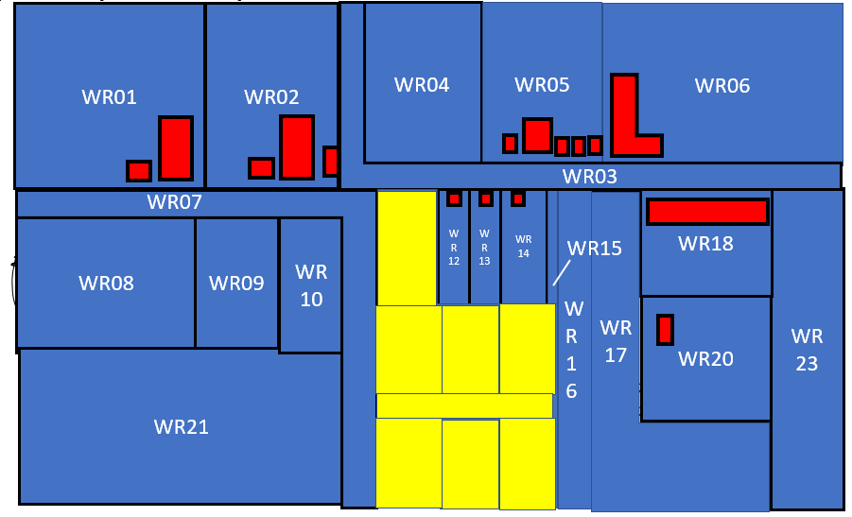
Implementation of the spatial plan means:
Transfer of ownership of BAU06 from the Cooperation to the Municipality
Ending Usufruct Right07
Ending Mortgage Restriction01
Subdivision of WR11 into 8 new Spatial units
This can be done in one transaction
Cooperation P06
Ownership Right06
Municipality P04
Usufruct Right07
BAU06
WR11
Capital Bank P07
Mortgage Restriction01

Slide 81
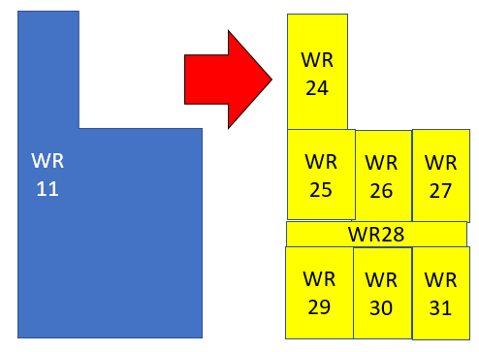
Cooperation P06
Ownership Right06
BAU06
WR11
Municipality P04
Usufruct Right07
WR24
Capital Bank P07
Mortgage Restriction01
WR25
WR26
WR27
WR28
Municipality P04
OwnershipRight22
BAU17
WR29
WR30
WR31

Slide 82
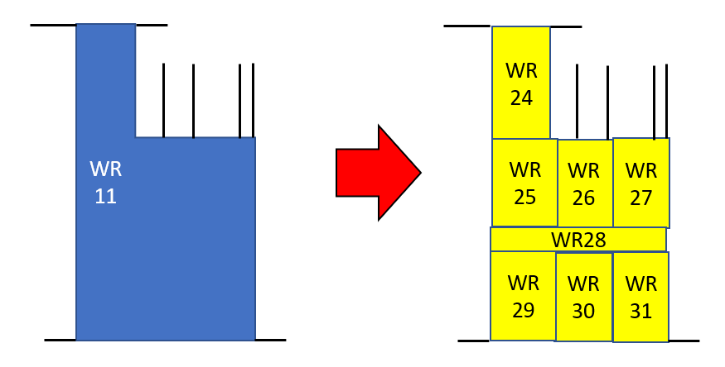
Subdivision

Slide 83
Coordinates of Boundary Points
1
2
1
2
6
3
5
6
11
3
4
6
3
4
12
6
5
7
19
5
7
18
20
21
13
5
17
23
22
14
9
8
9
16
15
8

Slide 84
Coordinates of Reference Points
28
10
27
26
25
24
24
24

Slide 85
Coordinates of all points
1
2
1
2
28
6
3
5
6
3
4
11
6
3
4
12
6
5
7
19
5
7
10
27
26
25
18
20
21
13
5
17
23
22
14
24
24
24
9
8
9
16
15
8

Slide 86
BFS001
1
2
1
X001 Y001
BFS002
2
3
4
2
X002 Y002
4
5
3
X003 Y003
BFS003
4
X004 Y004
BFS004
5
6
5
X005 Y005
BFS005
6
7
WR11
6
X006 Y006
BFS006
7
8
7
X007 Y007
BFS007
8
9
8
X008 Y008
BFS008
9
1
9
X009 Y009
10
X010 Y010

Slide 87
So far slides correct

Slide 88
Transaction 05: Establishment of servitudes – free wind catch

Slide 89
Transaction 04: Subdivide WR11
WR04
WR03
WR01
WR02
WR05
WR06
WR02
WR02
WR04
WR05
WR05
WR06
WR06
WR01
WR01
WR03
WR03
WR16
WR07
WR16
WR
12
WR
13
WR
14
WR16
WR18
WR
23
Servitude
WR11
WR
15
WR
13
WR
15
WR
13
WR17
WR
14
WR17
WR
12
WR
14
WR
12
WR22
WR08
WR21
WR22
WR09
WR
11
WR21
WR
11
20
20
WR24
WR
10
WR23
WR24
WR18
WR23
WR18
WR19
WR19
Servitude
WR07
WR07
WR30
WR
09
WR30
WR
09
WR20
WR32
WR08
WR32
WR08
WR29
WR
17
WR
10
WR29
WR
10
WR31
WR31
WR21
WR15
WR26
WR25
WR26
WR25
WR37
WR34
WR37
WR
28
WR34
WR27
WR
28
WR27
WR38
WR38
WR39
WR35
WR39
33
WR35
33
WR40
WR36
WR40
WR36

Slide 90
Transaction 0
WR04
WR03
WR01
WR02
WR05
WR06
WR02
WR02
WR04
WR05
WR05
WR06
WR06
WR01
WR01
WR03
WR03
WR16
WR07
WR16
WR
12
WR
13
WR
14
WR16
WR18
WR
23
Servitude
WR11
WR
15
WR
13
WR
15
WR
13
WR17
WR
14
WR17
WR
12
WR
14
WR
12
WR22
WR08
WR21
WR22
WR09
WR
11
WR21
WR
11
20
20
WR24
WR
10
WR23
WR24
WR18
WR23
WR18
WR19
WR19
Servitude
WR07
WR07
WR30
WR
09
WR30
WR
09
WR20
WR32
WR08
WR32
WR08
WR29
WR
17
WR
10
WR29
WR
10
WR31
WR31
WR21
WR15
WR26
WR25
WR26
WR25
WR37
WR34
WR37
WR
28
WR34
WR27
WR
28
WR27
WR38
WR38
WR39
WR35
WR39
33
WR35
33
WR40
WR36
WR40
WR36

Slide 91
Party Package

Slide 92
Party Package

Slide 93
Party Package

Slide 94
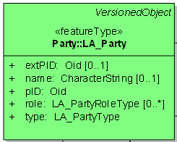
extPID | name | pID | role | type

Slide 95
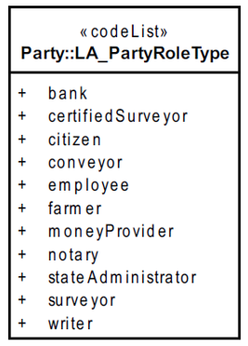
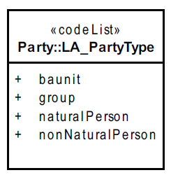
Datatypes
Oid means the datatype is Object-identifier
There can be [0…1]
Oid means the datatype is Object-identifier
There can be [0…1]

Slide 96
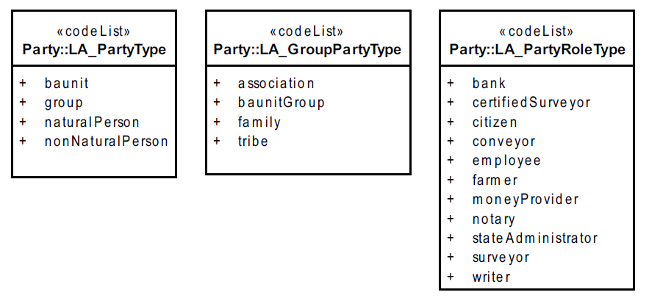
Code Tables Party Packages

Slide 97
extPID | name | pID | role | type

Slide 98
extPID | name | pID | role | type
- | Carlos | P01 | Citizen | naturalPerson
- | Thomas | P02 | Citizen | naturalPerson
- | Elizabeth | P03 | Citizen | naturalPerson
- | Municipality | P04 | Government | nonNaturalPerson
- | Anna | P05 | Citizen | naturalPerson
- | Cooperation | P06 | Citizen | naturalPerson
- | Capital Bank | P07 | Money Provider | nonNaturalPerson
 | Housing Company

Slide 99
rID | Type | Sha
Right01 | Ownership | 1
Right02 | Ownership | 1/2
Right02 | Ownership | 1/2
Right03 | Ownership | 1
Right04 | Ownership | 1
Right05 | Ownership | 9/10
Right06 | Ownership | 1/10
Right07 | Usufruct
Right08 | Ownership
Right09 | Ownership | 1/2
Right10 | Ownership
Right11 | Leasehold | 1/2
Right11 | Leasehold | 1/2
Right12 | Leasehold
Restr01 | Mortgage
Restr02 | Mortgage
suID | area
WR01
WR02
WR03
WR04
WR05
WR06
WR07
WR08
WR09
WR10
WR11
WR12
WR13
WR14
WR15
WR16
pID | Name
P01 | Carlos
P02 | Thomas
P03 | Elisabeth
P04 | Municipality
P05 | Anna
P06 | Cooperation
P07 | Capital Bank
P08 | Housing Company
P09 | Maria
P10 | Johan
P11 | Anton
P12
P13
…
BAU01
BAU02
BAU03
BAU04
BAU05
BAU06
BAU07
BAU08
BAU09

